Slide 1
Presentation of the bank
Year end 2016
Meeting March 29 with Matthew Hankin in Arbiter

Slide 2



Jæren Sparebank – an overview
  Strong local bank and alliance bank in the Eika Group - a nationwide partnership between 73 local savings banks
  Listed on Oslo Stock Exchange with equity certificate from 2007.
  About 70% of the bank's loans are to private individuals and a large proportion of other loans are for agriculture with a low risk.
  Transferred home loans at Eika Boligkreditt of NOK 4.5 billion. Volume outside the bank's balance sheet, but the bank receives commissions and dividends.
  The transfer ratio is 37.2% for home loans as of Q4 2016.
13.0
Total assets (billion)
33
Customers
(in 1,000s)
83
Man-labour years
1.5
Equity (billion)
582
Listed capital (million)
Source: Market value as of 26.08.2016

Slide 3
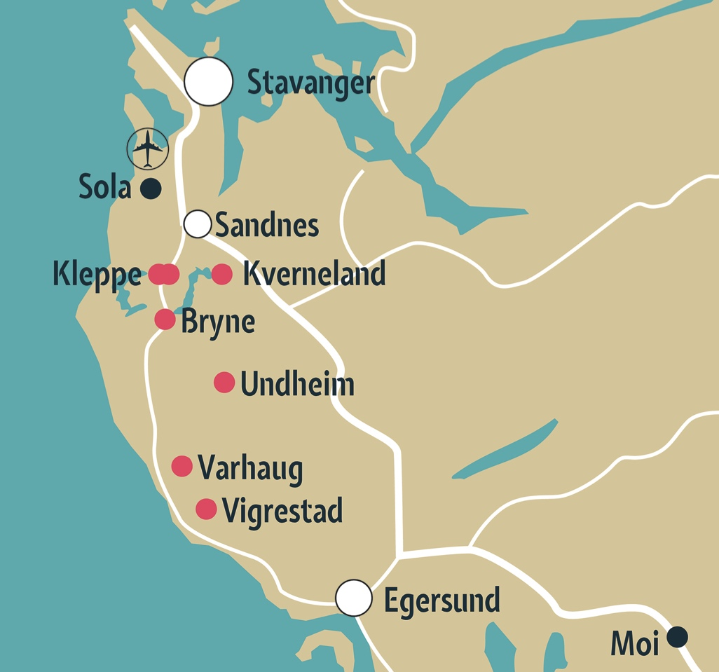



Small in global terms - a major player in Jæren
Market leader in Klepp, Time and Hå
Medium-sized listed bank
Seven offices strategically located throughout the entire Jæren region.
12th largest listed savings bank in Norway
Total assets (NOK billion)
Source: Total assets as of 31.03.2016

Slide 4
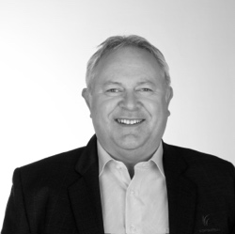
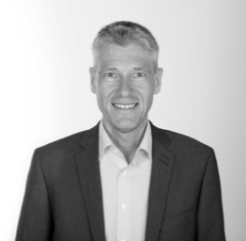
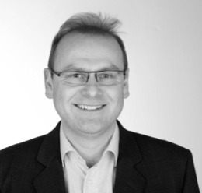
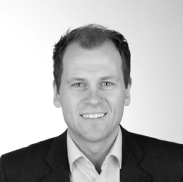
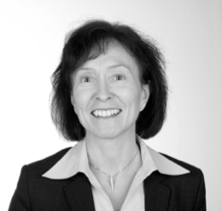
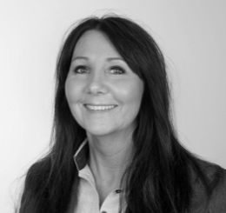
The people - Management and Board
Competent board
Experienced management
Per Bergstad – Chairman
Lawyer and Partner at ProJure Advokatfirma
Tor Audun Bilstad – Deputy Chairman
Farmer in Vik in Klepp
Marie Storhaug
Director of Global Back Office for Marketing and Sales of Oil and Gas at Statoil
Bjørg Helen Osvoll Mæland
Managing Director of Mæland Rør AS
Snorre Haukali
Lawyer and Managing Partner at Kluge Advokatfirma
Morten Erga – Employee representative
Elena Zahl Johansen – Employee representative
Tor Egil Lie
Managing Bank Director
Klas Stølsnes
Chief Financial Officer
Magne Stangeland
Risk Management and Compliance
Frode Flesjå
Corporate Market
Åse Bente S. Wærsland
Support and CF
June Kristin Lima
Retail Market
The board and management have a strong focus on building a Jæren savings bank for the long-term.

Slide 5
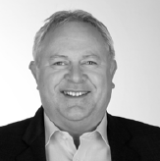
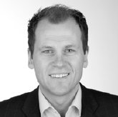
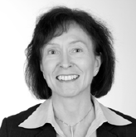
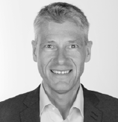
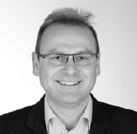
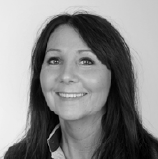
A competent and experienced management team
Tor Egil Lie
Frode Flesjå
CEO, Managing Bank Director
Bank Director, Corporate Market
Registered public accountant from the University College in Stavanger.
Managing Director at Revisor-Gruppen Stavanger.
Bank Director at Fokus Bank.
Director at Gjensidige Forsikring.
Bank Director at Klepp Sparebank.
CEO and Managing Bank Director at Jæren Sparebank
since January 2015.
Bachelor of Economics from BI Norwegian Business School in Stavanger, which included subjects such as
accounting, finance and marketing.
7 years as a full-time road race cyclist.
Bank Director, Corporate Market at Jæren Sparebank
since January 2015.
Åse Bente S. Wærsland
Klas Stølsnes
Bank Director, Joint Functions and Support
Bank Director, CFO
Bank Economist.
Was involved in establishing Stavanger Bank in 1987 and was responsible for operations/finance.
Worked as a consultant at EDB Business Partner AS.
Employed at Klepp Sparebank since 1988.
Bank Director, Joint Functions and Support at Jæren Sparebank since January 2015.
Business economist from Norwegian School of Economics.
Diverse work experience from local commerce and industry.
CFO at Ålgårds Auto Gruppen AS.
CFO at Time Sparebank since 2006.
Bank Director, CFO at Jæren Sparebank since January 2015.
Magne Stangeland
June Kristin Lima
Bank Director, Risk Management and Compliance
Bank Director, Retail Market
Master's programme in operational audit and risk management from the BI Norwegian Business School and registered public accountant.
Experience from KPMG, Nord-Jæren kommunerevisjon and Erga Revisjon.
Employed at Klepp Sparebank since 2006.
Bank Director, Risk Management and Compliance at Jæren Sparebank since January 2015.
College graduate in business administration/economics with supplementary subjects from BI Norwegian Business School and the Norwegian University of Science and Technology (NTNU).
Vice President of Pareto PPN, part of the Pareto Group.
Bank Director, Retail Market at Jæren Sparebank since August 2015.

Slide 6
Solid Board of Directors
Per Bergstad – Chairman
Lawyer and partner at ProJure Advokatfirma DA where he is also chairman. Deputy chairman at Time Sparebank 2008-2014. Has held numerous board positions and chairmanships, both locally and nationally. Resides in Bryne.
Tor Audun Bilstad – Deputy Chairman
Farmer with agricultural and commerce education. Has been on the boards of many companies and associations both locally and nationally in the past 30 years and has political experience from the municipal council and executive committee in Klepp, where he has also served as Deputy Major. Board member and Chairman at Klepp Sparebank from 2008-2014. Resides in Vik in Klepp.
Bjørg Helen Osvoll Mæland
Managing Director and owner of Mæland Rør AS. Extensive experience as a business owner and solid accounting experience. Good knowledge of and active participation in commerce and industry in Jæren. Boardroom experience from various organisations and industries. Member of general assembly and nomination committee at Sparebankstiftinga Time og Hå. Resides in Sirevåg.
Snorre Haukali
Lawyer and Managing Partner at Kluge Advokatfirma. Solid experience within corporate finance, company law, corporate governance, banking and financing and contract law. Extensive boardroom experience and was a board member at Klepp Sparebank from 2010-2014. Resides in Stavanger.
Marie Storhaug
Employed at Statoil as Director of Global Back Office for Marketing and Sales of Oil and Gas. Was previously Chief Accountant for Crude Oil, CNG and Refined Products, CFO for Finance and CFO for Cash Management at Statoil She has boardroom experience from various companies and organisations. Has political experience and is presently a member of the municipal council and executive committee in Klepp. Resides in Kleppe.
Morten Erga
Employee representative on the board and has worked as a retail market consultant at our office in Varhaug since 2009. Is the senior employee representative at the bank. Has previous experience from Sparebank 1 SR Bank and has his own investment activities. Resides in Kleppe.
Elena Zahl Johansen
Employee representative on the board and retail market consultant at the head office in Bryne. Has been employed since 2011 and has a Bachelor of Economics from BI Norwegian Business School in Trondheim.
Resides in Bryne.

Slide 7

Retail market – by far the largest proportion of lending
22 customer consultants
Klepp: 2 branches
Time: 3 branches
Hå: 2 branches

Slide 8

Jæren business is our business
The corporate market services small and medium-sized local companies.
10 consultants, 4 of whom are dedicated to agriculture.
Located together in Bryne to offer extensive and competent services.

Slide 9
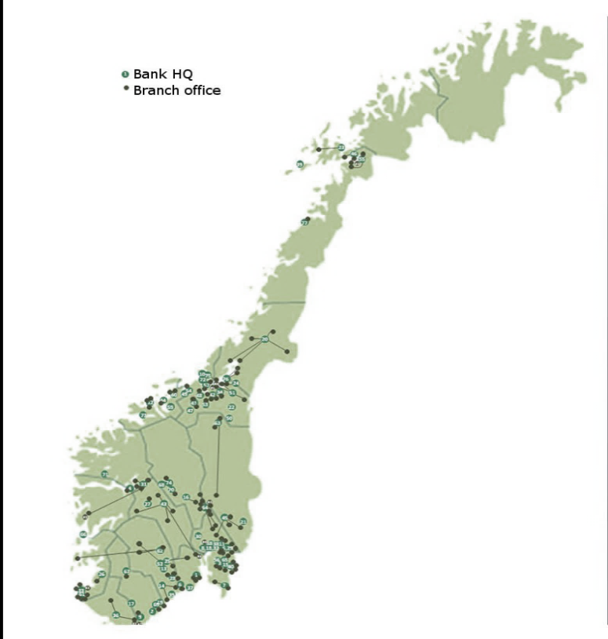

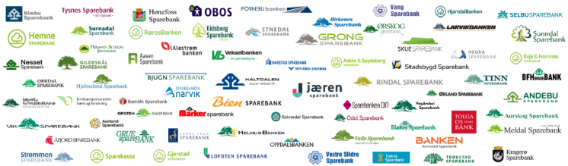
Major value from ownership in the Eika Alliance
73 Eika banks
Present in 18 of 19 counties
Third largest bank grouping in Norway
210 offices and 2,400 employees
Total assets of close to NOK 300 billion
Technology
IT
Regulatory
Influence and strategy
Together a major player
Insurance
Real estate business
Other services
Funding (EBK)

Slide 10

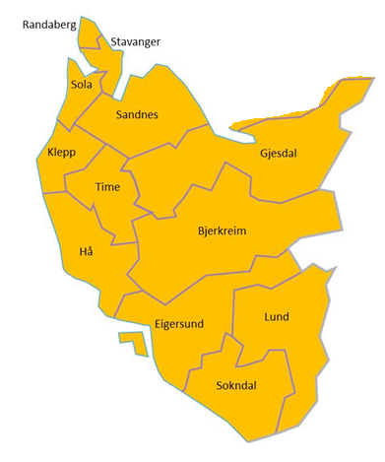
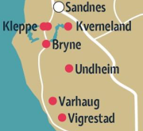
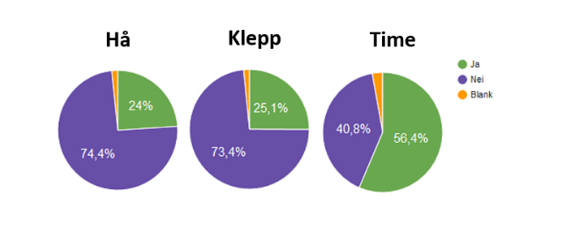
Jær Region
113%
The Jær region comprises three municipalities
Key figures
Approximately 60,000 inhabitants in the three municipalities.
According to Statistics Norway (SSB), Klepp, Time and Hå are the municipalities in Rogaland with the fastest population growth.
Previously planned municipal mergers, in which Bryne was designated as the centre, are not likely in the near future - despite the fact that the people of Time voted yes.
Geographical proximity still makes it possible for the collaborative solutions that are already established to be further developed.
Referendums - municipal mergers
Source: NRK.no/MINNYEKOMMUNE.NO

Slide 11
The oil crisis has resulted in increased unemployment and a slight fall in property prices
Jæren has lower unemployment than Rogaland as a whole
Property prices fallen from their peak
The increase in unemployment in the region, low oil price and a slight fall in property prices have had little impact on the bank's operations thus far. It must still be expected that there will be a somewhat lower level of activity in our region in the time ahead, due to, among other things, the low oil price. In addition, high unemployment could contribute to slightly reduced property prices. The total number of unemployed in the bank's three municipalities is approximately 1,100 people.
Source: SSB, Eiendom Norge

Slide 12


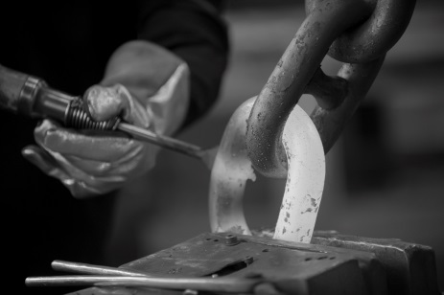


Diverse industry structure, stable industries
Employment by sector
Klepp and Hå are the two largest agricultural municipalities in Rogaland.
Large agricultural area with agricultural activity in addition to manufacturing of agricultural equipment.
The world's largest manufacturer of agricultural equipment is located in Klepp.
High public sector presence and low level of oil-related activity compared with other parts of Rogaland.
Commerce
Public sector etc.
Industry, building and construction
Agriculture

Slide 13
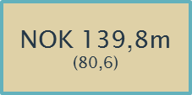

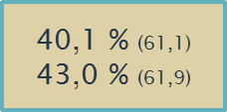

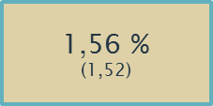
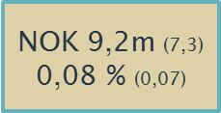
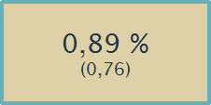
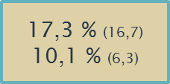
Operations for the year 2016
Profit after tax
Cost ratio
Cost ratio, excluding valuechanges
Net interest
Losses
Losses as a % of gross lending
Other income
Core tier 1 capital
Return on equity (ROE)
Stable underlying operations in a market that has been characterised during the year by a low interest rate and continued strong competition.
The bank is now seeing the effects of cost-cutting measures carried out towards the end of 2015 - restructuring and downsizing.

Slide 14
The bank's income
Income up 8,3 % from 2015
MNOK

Slide 15
The bank's costs
Costs down 26,5 % from 2015 (11,4 %)
MNOK

Slide 16
The bank's profit and ROE
2015 – ROE 6,3 %
2016 – ROE 10,1 %
MNOK

Slide 17
Net interest – share of total income
%
Average 68 % in 2015 og 65 % in 2016

Slide 18

Commission
Mill kr

Slide 19
Important principles in our credit assessment
We work on the basis of some important fundamental rules – our three Cs:
Competence
We shall not become involved in industries in which we have no expertise or insight. Typical example for us has been to stay away from everything involving oil.
Capacity
We shall have the necessary capacity to follow-up large and demanding customers. This involves us having to carefully assess what it will require in terms of the bank's time to provide adequate
follow-up for the customer.
Complex ownership arrangements
We do not become involved in companies with complex ownership arrangements - when there are often also several banks involved - when we are not the main bank etc.

Slide 20
Distribution of loans– own balance sheet
69%
69 %
31 %
69% retail market and 31% corporate market - of which 82% is agriculture/property.
This does not include NOK 4.5 billion in EBK. When EBK is included the retail market is 78%.

Slide 21

A stable and solid bank
Stable balance sheet structure
Steady return on equity and core capital
The bank is well-equipped for future growth - with the necessary capital base.
The growth curve in the future will most probably not be too steep - controlled, well-measured and profitable growth are important key words.
The target for the return on equity after tax is a minimum of 7,5%.

Slide 22


Development in lending
MNOK
Growth in 2015 + 3,5 %
Growth in 2016 + 6,4 %

Slide 23
Development in funding
MNOK

Slide 24
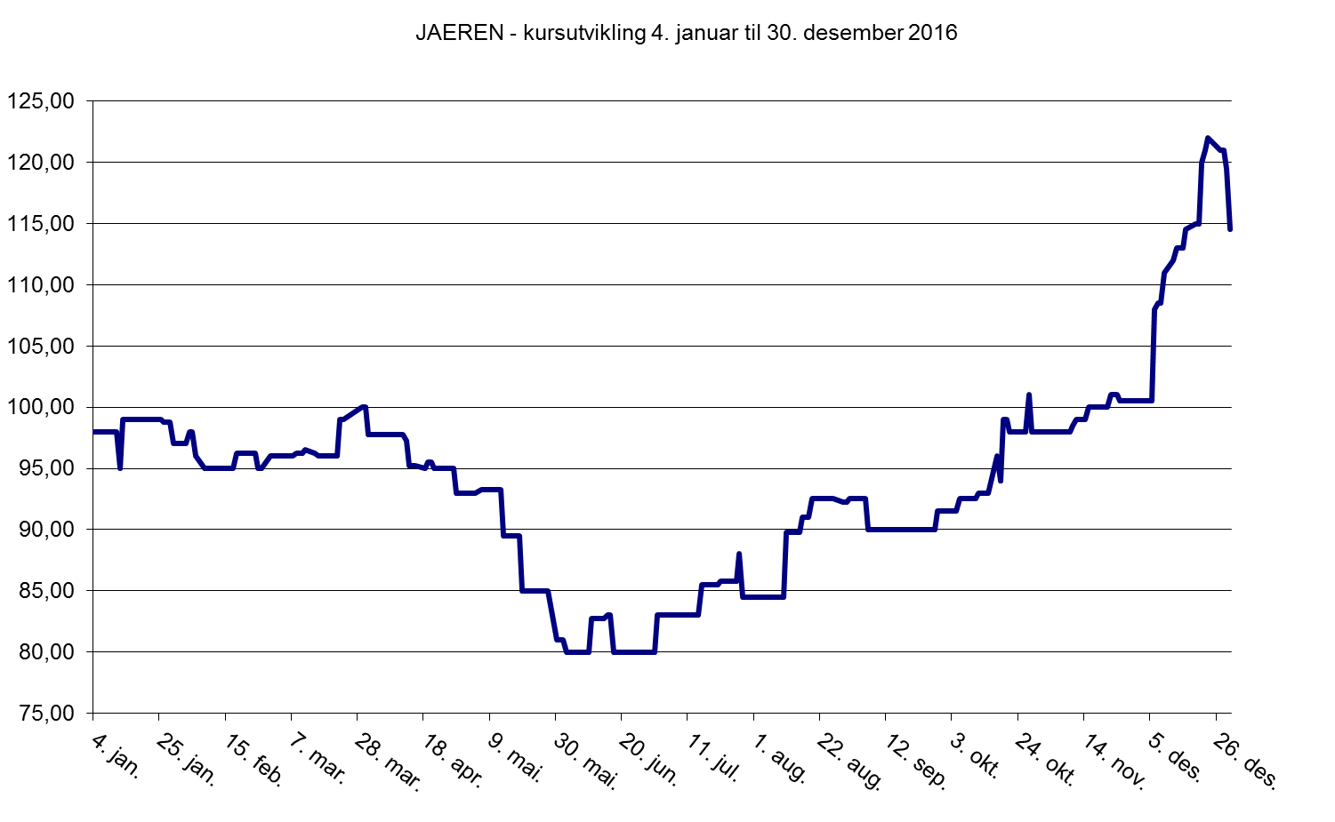
JAEREN in 2016

Slide 25
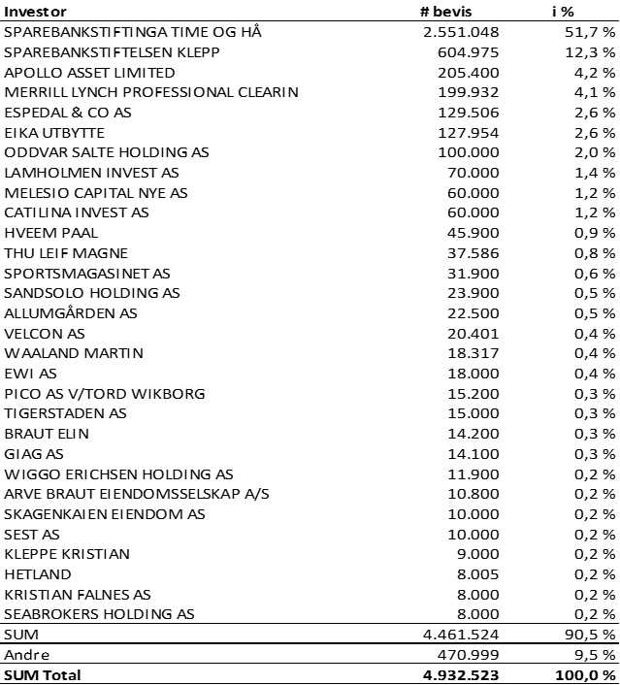
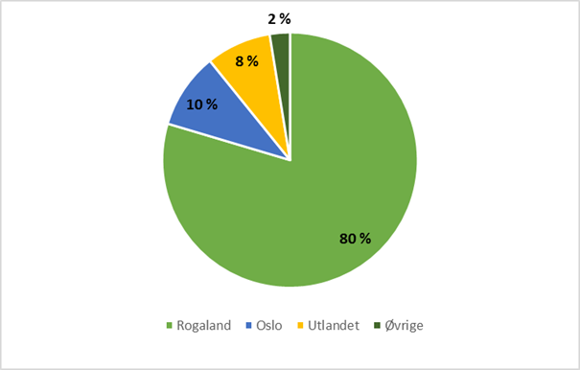
Equity certificate and owners
Ownership structure
Geographical spread of owners 31.12.2016
As of 31.12.2016 there were 783 owners.
The 30 largest owners in Jæren Sparebank hold 90.5% of the outstanding equity certificates.
As of the present date 4.935.523 equity certificates have been issued.
Geographical distribution:

Slide 26
DISCLAIMER
This document is only for information purposes and must not be used or distributed without having first agreed to this with Jæren Sparebank.
Among other things, the company presentation includes information about Jæren Sparebank's previous, current and future activities, financial matters relating to the bank and commercial considerations at a local and regional level.
The information is based on assumptions and observations in accordance with how the bank assesses these and that were made on the date of the presentation and no guarantee is given that these cannot be or have already been changed.
The presentation also contains third party information, obtained from publicly available sources, that are trusted without further quality control or verification.
The presentation is not a form of offer to invest in any form of securities issued by the bank.
The presentation may be altered without the bearer being informed of this, if it is discovered that there are errors or outdated or inadequate information.
Figures for 2011-2014 are pro forma comparative figures for the 2 previous banks - Klepp Sparebank and Time Sparebank

